Slide 1
MODFLOW 6 Input / Output

Slide 2
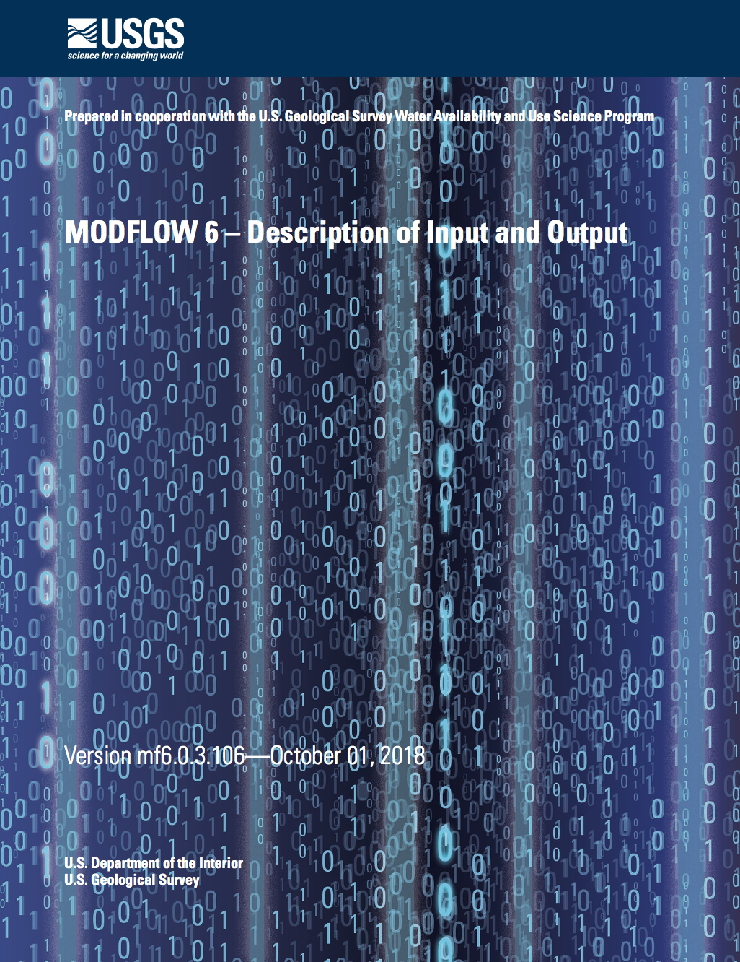
mf6io.doc
Comes with MODFLOW 6

Slide 3
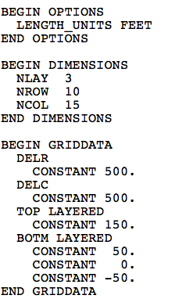
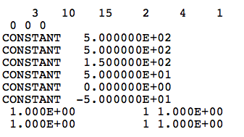
Input Format: Blocks and Keywords
MODFLOW 6 DIS
MODFLOW-2005 DIS

Slide 4
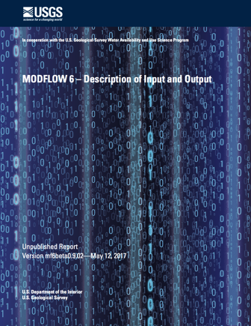
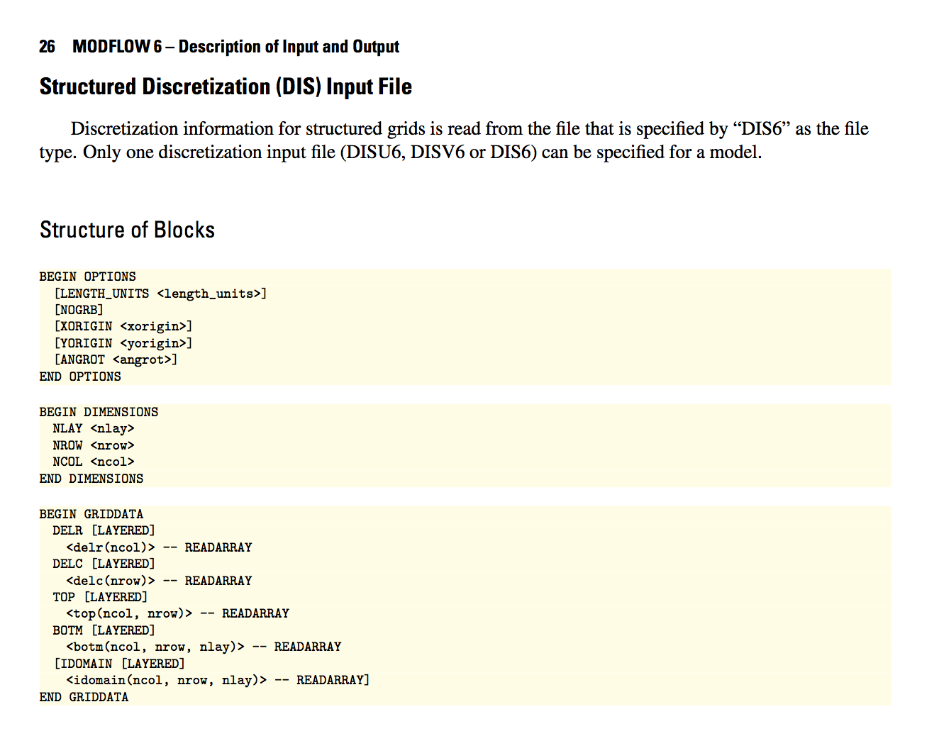
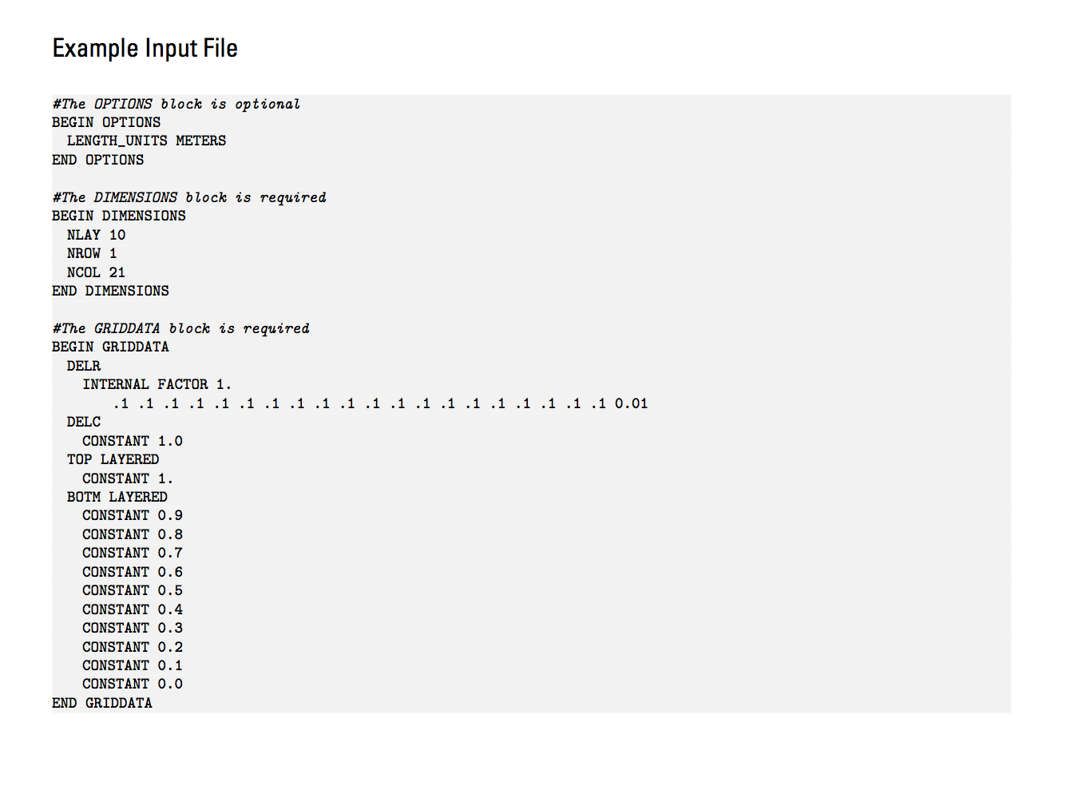
Blocks and Keywords
Notes:
Human readable
Better error trapping
Easily allows new options to be added, without breaking backward compatibility
Most blocks support OPEN/CLOSE

Slide 5
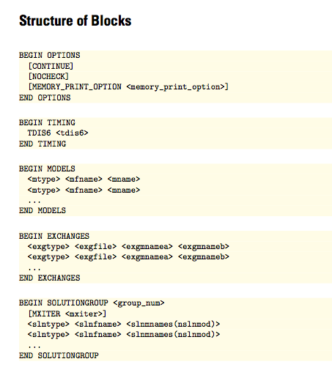
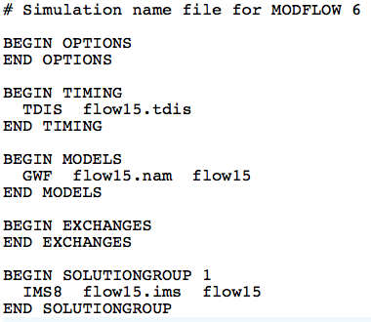
Simulation Name File
Required even for common case with one model
Named mfsim.nam
One simulation per folder

Slide 6
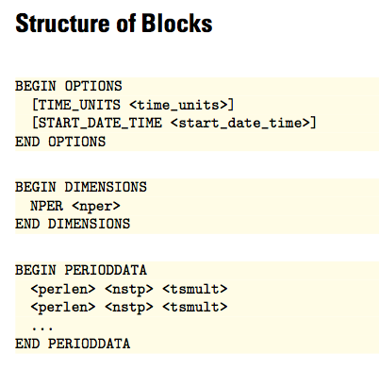
Temporal Discretization
BEGIN OPTIONS
TIME_UNITS DAYS
END OPTIONS
BEGIN DIMENSIONS
NPER 4
END DIMENSIONS
BEGIN PERIODDATA
1.0 1 1.0
31.0 31 1.0
28.0 28 1.0
31.0 31 1.0
30.0 30 1.0
END PERIODDATA

Slide 7
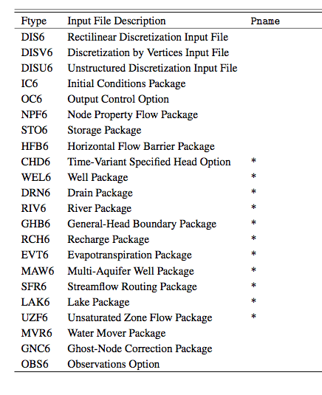
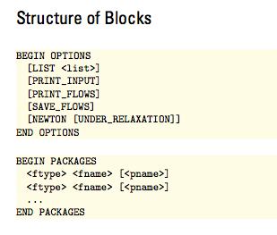
GWF Name File

Slide 8
Example GWF Name File
BEGIN OPTIONS
END OPTIONS
BEGIN PACKAGES
DIS6 ps1.dis
IC6 ps1.ic
NPF6 ps1.npf
CHD6 ps1.chd
END PACKAGES

Slide 9
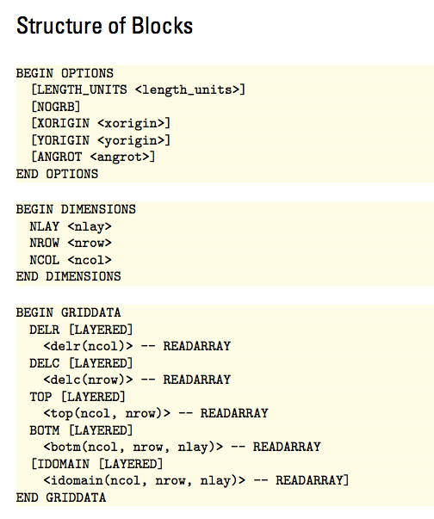
DIS Input File

Slide 10
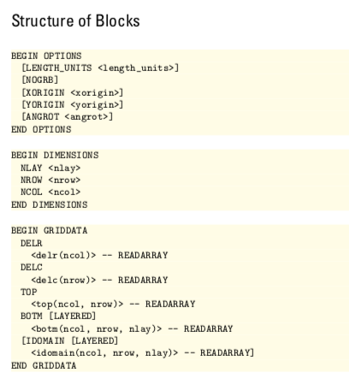
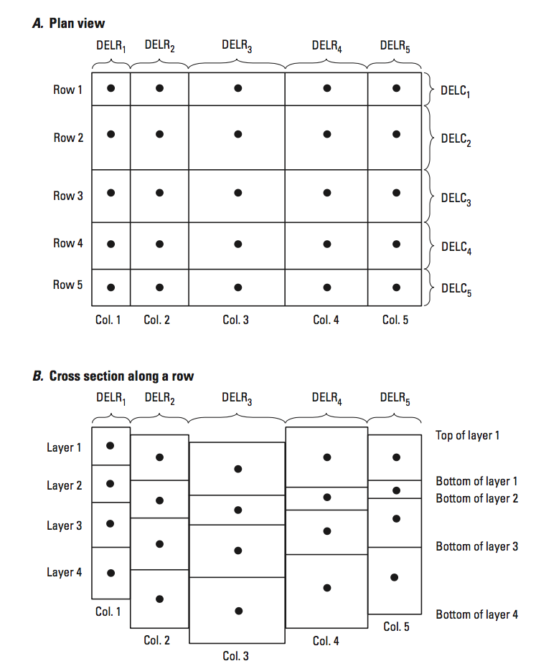
DIS Input File

Slide 11
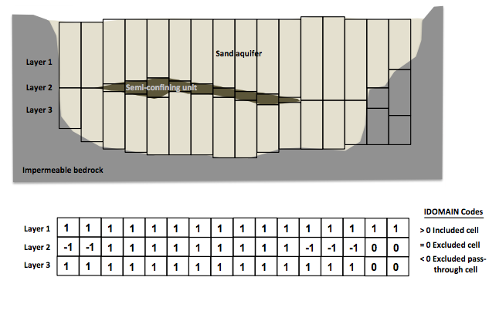
DIS Input File

Slide 12
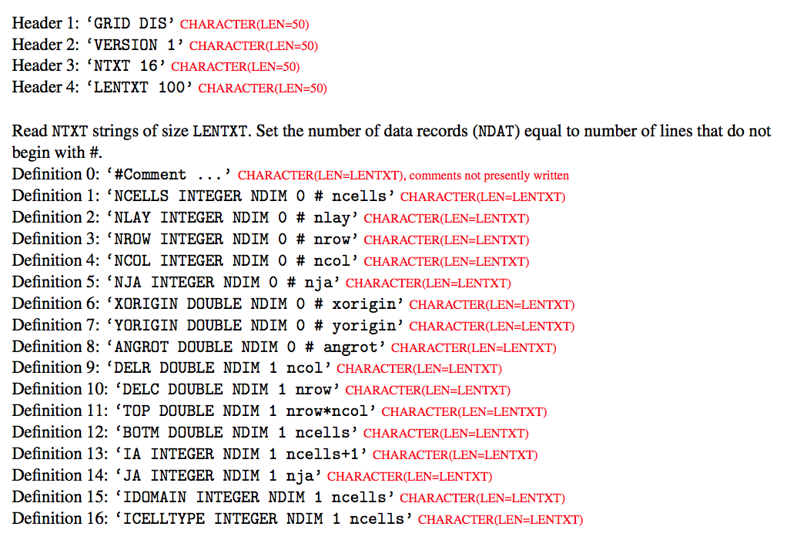
DIS Input File
Binary Grid File

Slide 13
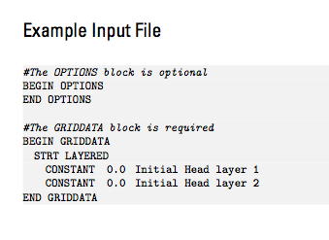
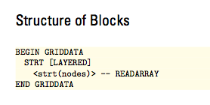
Initial Conditions
Specify starting heads
A head value below cell bottom elevation will start the cell as dry
Always required, even for steady-state simulations

Slide 14
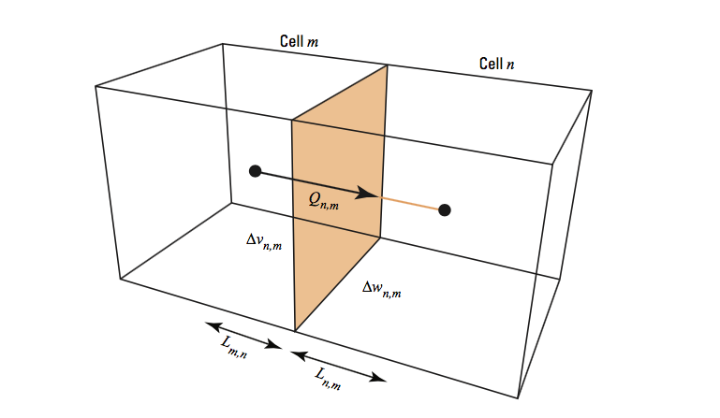
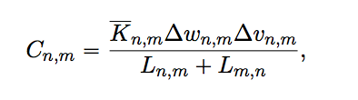
Node Property Flow (NPF) Package
Calculates conductance between cells
Manages cell wetting and drying
Can invoke an optional XT3D formulation

Slide 15
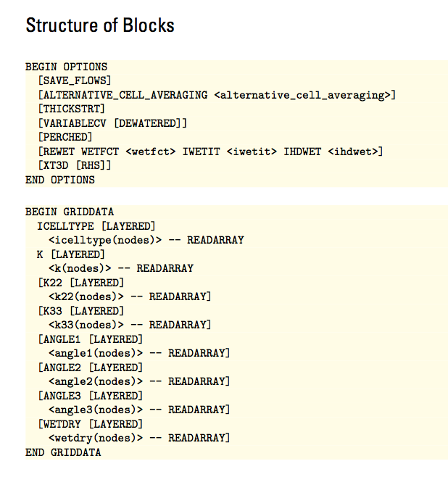
NPF Input File

Slide 16
NPF Input File
ICELLTYPE=0: cell is treated as confined for conductance calculations
ICELLTYPE=1: cell converts between confined and unconfined depending on head

Slide 17
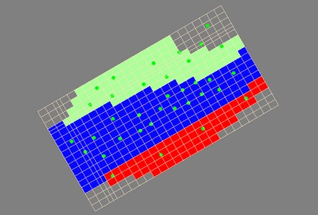
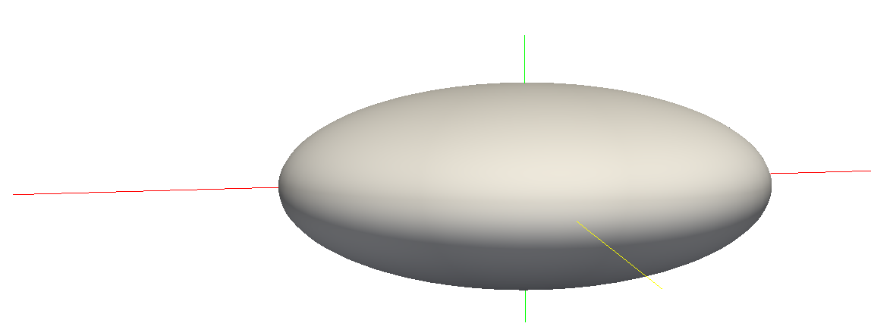
NPF Input File
K
K22
K33

Slide 18
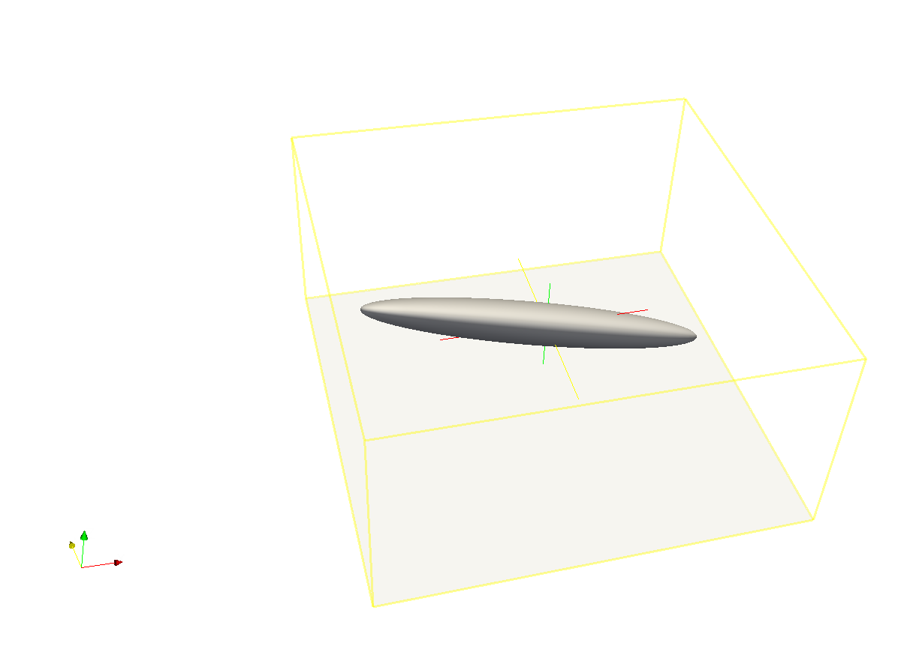
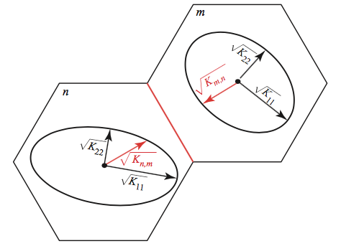
NPF Input File
Conductivity ellipsoid (for any cell) can be rotated around its three axes

Slide 19
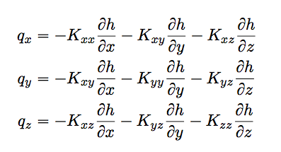
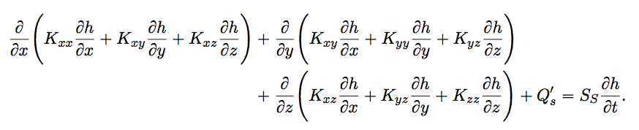
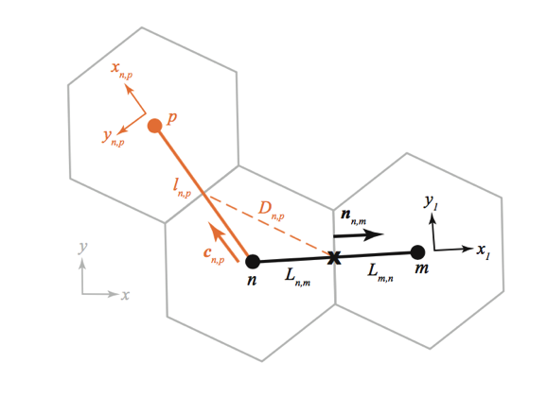
NPF Input File
XT3D Option more robust, but computationally expensive

Slide 20
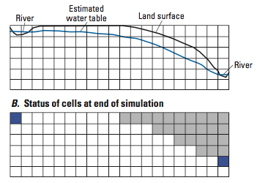
NPF Input File
MODFLOW rewetting can be used to reactivate cells that have gone dry
Rewetting is no longer recommended. Use Newton-Raphson instead!

Slide 21
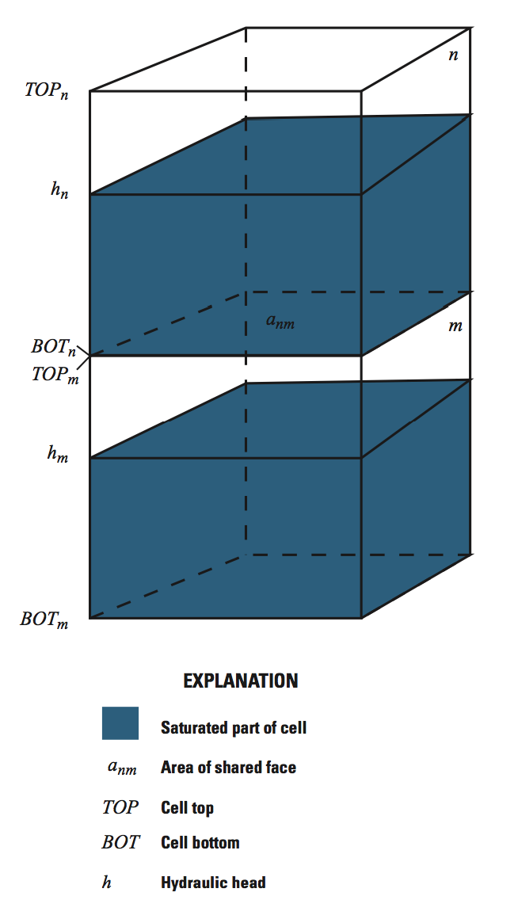
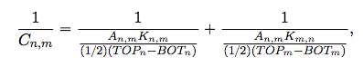
NPF Input File
Vertical conductance calculation: DEFAULT (most stable)

Slide 22
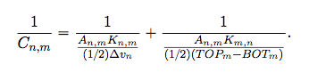
NPF Input File
Vertical conductance calculation: VARIABLECV

Slide 23
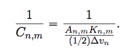
NPF Input File
Vertical conductance calculation: VARIABLECV and DEWATERED

Slide 24
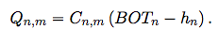
NPF Input File
Vertical flow calculation: PERCHED

Slide 25
Boundary Packages

Slide 26
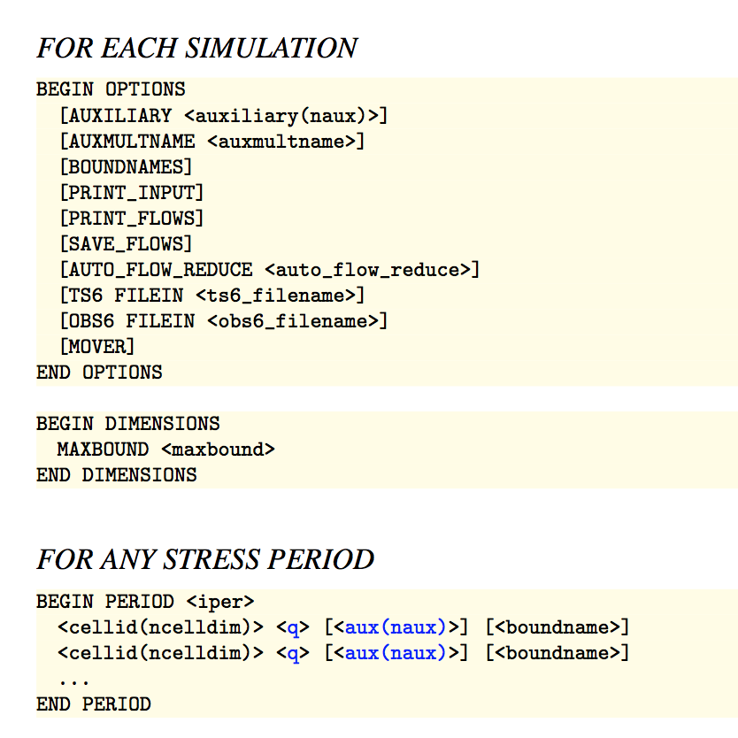
Well (WEL) Package

Slide 27
Well (WEL) Package
MAXBOUND is the maximum number of boundary cells that will be active in any stress period.
BEGIN OPTIONS
END OPTIONS
BEGIN DIMENSIONS
MAXBOUND 1
END DIMENSIONS
BEGIN PERIODDATA
3 11 10 -1.5E5
END PERIODDATA

Slide 28
Well (WEL) Package
List of boundary cells. These cells will remain as boundary cells until another PERIOD block is encountered.
BEGIN OPTIONS
END OPTIONS
BEGIN DIMENSIONS
MAXBOUND 1
END DIMENSIONS
BEGIN PERIODDATA
3 11 10 -1.5E5
END PERIODDATA

Slide 29
Well (WEL) Package
Auxiliary variables
BEGIN OPTIONS
AUXILIARY IFACE
END OPTIONS
BEGIN DIMENSIONS
MAXBOUND 1
END DIMENSIONS
BEGIN PERIODDATA
3 11 10 -1.5E5 0
END PERIODDATA

Slide 30
Well (WEL) Package
Boundnames
BEGIN OPTIONS
BOUNDNAMES
END OPTIONS
BEGIN DIMENSIONS
MAXBOUND 1
END DIMENSIONS
BEGIN PERIODDATA
3 11 10 -1.5E5 MYWELL
END PERIODDATA

Slide 31
Well (WEL) Package
PRINT_INPUT: echo input to the listing file
PRINT_FLOWS: write calculated CHD flows to the listing file
SAVE_FLOWS: write calculated flows to budget file
BEGIN OPTIONS
PRINT_INPUT
PRINT FLOWS
SAVE_FLOWS
END OPTIONS
BEGIN DIMENSIONS
MAXBOUND 1
END DIMENSIONS
BEGIN PERIODDATA
3 11 10 -1.5E5
END PERIODDATA

Slide 32
Well (WEL) Package
Variables shown in blue can be represented using time series. Values are interpolated each time step from a user-provided time series record.

Slide 33
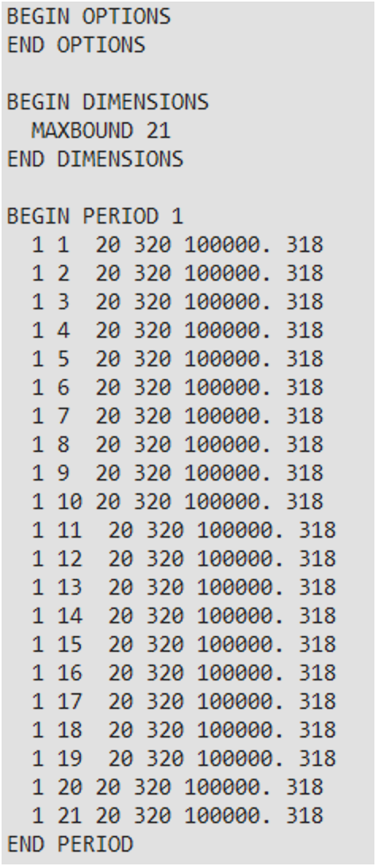
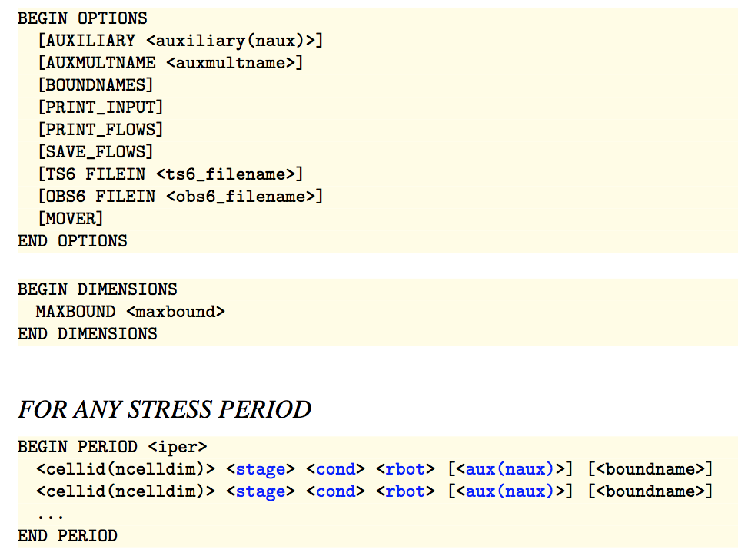
River (RIV) Package

Slide 34
Recharge (RCH) Package
Legacy array style (READASARRAYS)
Only works for DIS and DISV GWF Models
Easy to specify constant values
List style
More flexibility
Can specify multiple recharge rates for a single cell (perhaps based on land use, for example)
Also applies to EVT

Slide 35
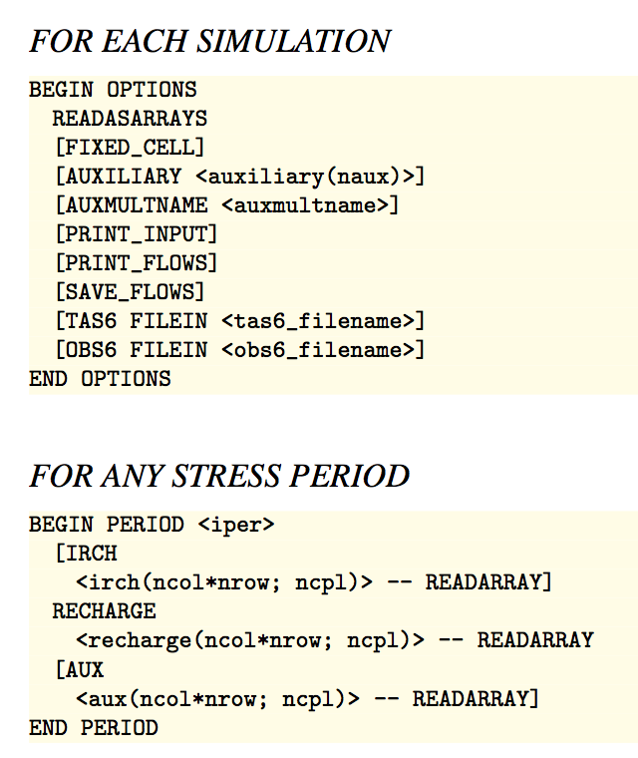
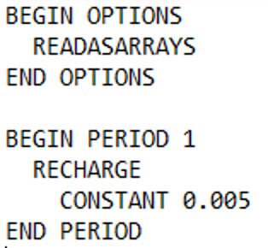
Recharge (RCH) Package

Slide 36
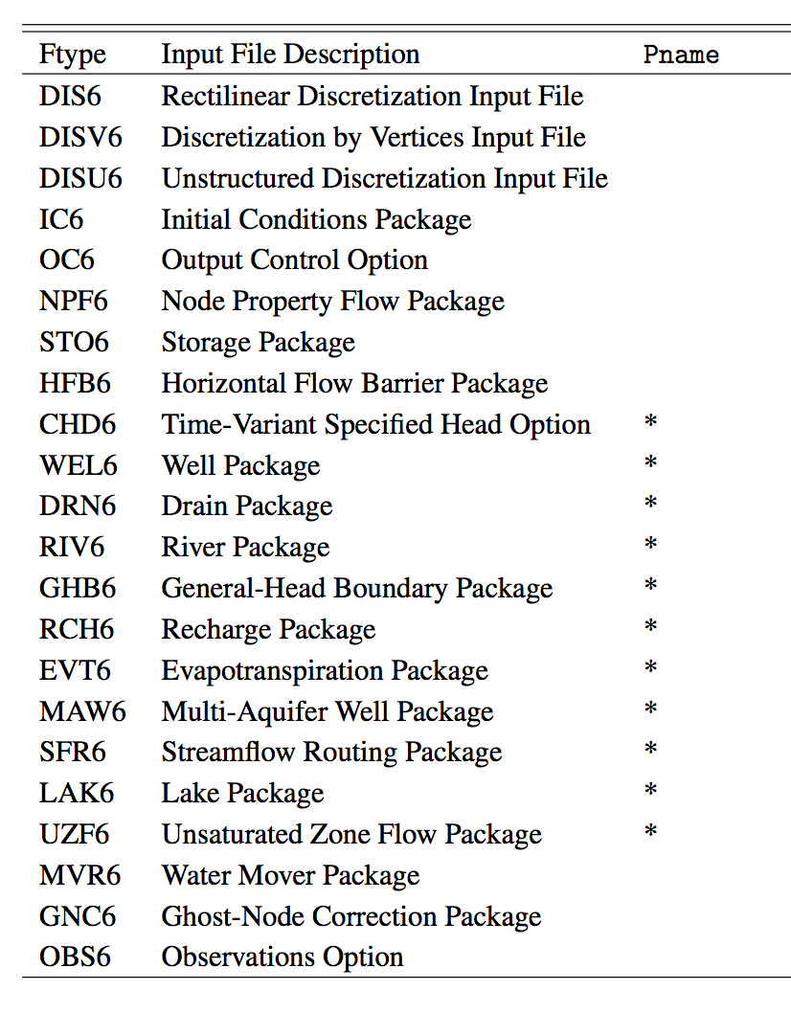
Multiple Packages of Same Type

Slide 37
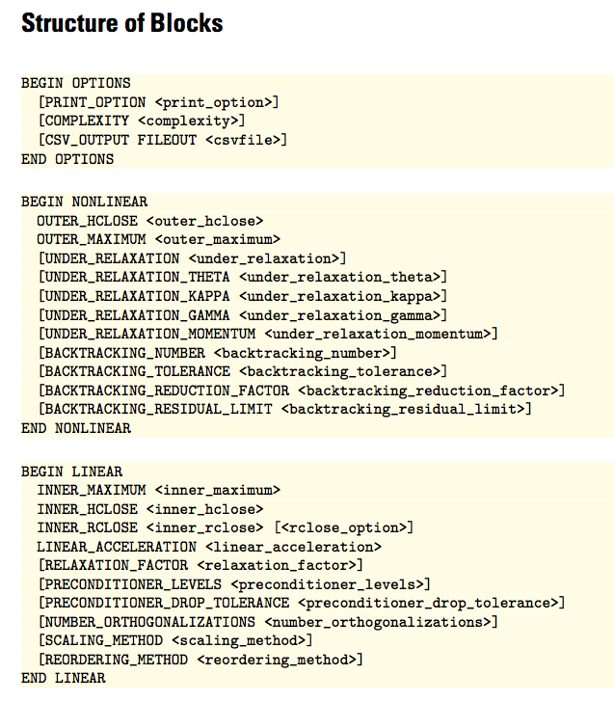
IMS Input File
BEGIN OPTIONS
COMPLEXITY SIMPLE
END OPTIONS
BEGIN NONLINEAR
END NONLINEAR
BEGIN LINEAR
END LINEAR

Slide 38
Types of Output
Listing files
Simulation list file (mfsim.lst)
Model list file (e.g. ps1.lst)
Heads
Automatically printed to GWF list file at end of stress period
Can also be written to a binary file
Budgets
Can be written to GWF list file (not recommended)
Can also be written to a binary file
Observations
Written to CSV (comma separated value) files
Binary Grid File
Always written; useful for post processors
All binary files are double precision

Slide 39
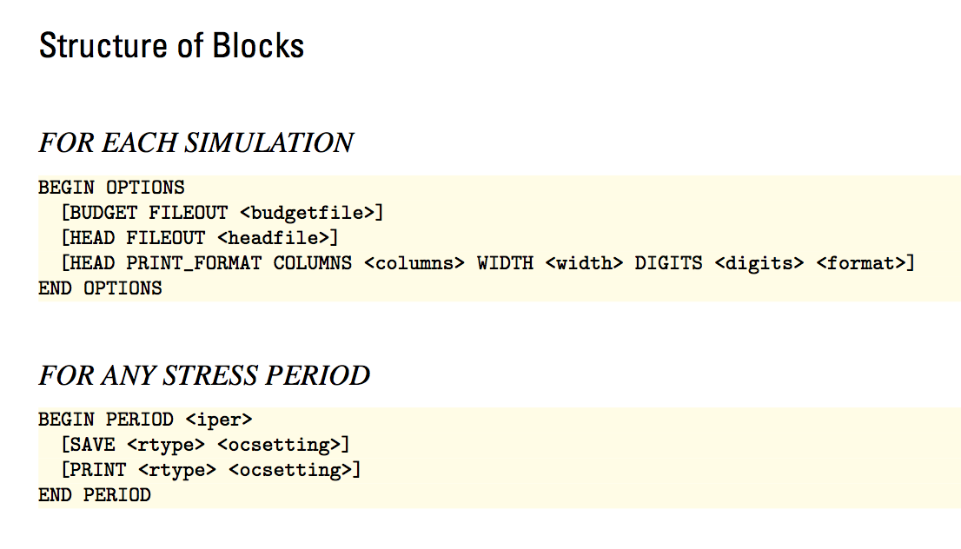
Output Control File
Specified in GWF name file as “OC6”

Slide 40
Output Control File
Names of budget and head files to create

Slide 41
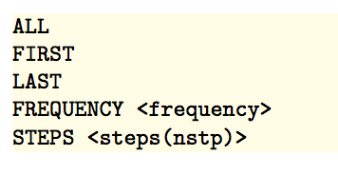
Output Control File
How often to save or print for the stress period
e.g. SAVE HEAD LAST

Slide 42
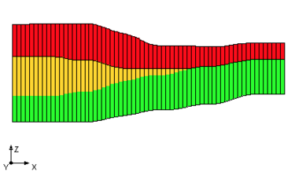
IDOMAIN Capability (cont.)
How does IDOMAIN affect flows written by MODFLOW?
Cell connections are more flexible, so needed to rethink “FLOW RIGHT FACE”, ...
Cell connectivity is written to the “binary grid file”
Flows between adjacent cells, “FLOW JA FACE”, corresponds to cell connectivity in binary grid file

Slide 43
First MODFLOW 6 Problem

